Slide 1
Identification & Classification of Diabetic Retinopathy
Under Guidance of
Dr. Himadri Sekhar Dutta
Contributors :-
Ayush Singh 10200319009
Aryan Shaw 10200319012 Mayukh Sen 10200319014
Agni Sain 10200319019

Slide 2
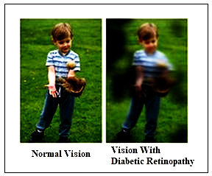
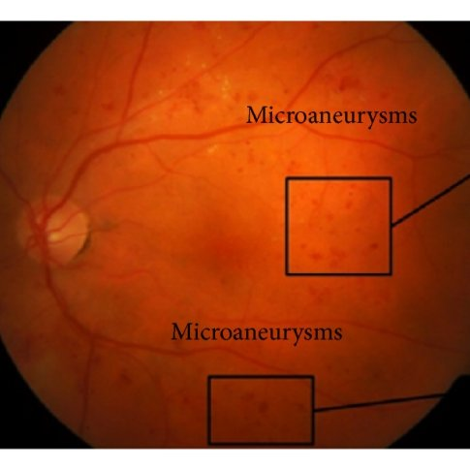
What Is Diabetic Retinopathy?
Diabetic retinopathy is a diabetes complication that affects eyes. It's caused by damage to the blood vessels of the light-sensitive tissue at the back of the eye
Microaneurysms (MA) is usually the first symptom of DR that causes blood leakage to the retina. This lesion usually appears as small red circular spots with a diameter of fewer than 125 micrometers.

Slide 3
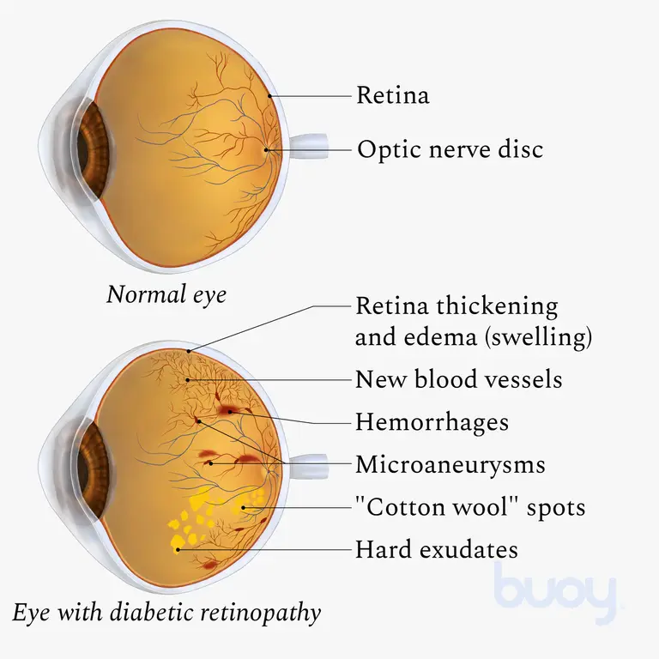

Slide 4
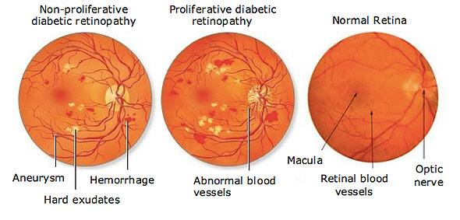
Types Of Diabetic Retinopathy
Notes:
roliferative retinopathy: New blood vessels form, but they are unstable, with weak walls, so they may leak fluid or blood. They grow over the retina, which can lead to vision loss.
Non-proliferative retinopathy: Blood vessels in the retina deteriorate, and then become blocked and deformed. Proteins, fluids, and fats leak out of these vessels and collect in the retina. This causes swelling, which leads to poor visual acuity, or blurry vision.

Slide 5
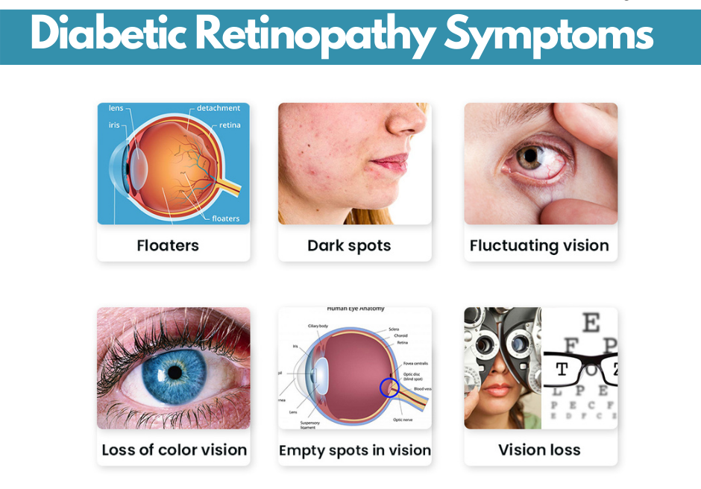
Symptoms Of Diabetic Retinopathy
Symptoms of diabetic retinopathy may include:-
Blurry vision.
Sudden vision loss in one or both eyes.
Black spots.
Flashing lights.
Trouble reading, seeing detailed work, or seeing other things up close.

Slide 6
Problem Statement
Diabetic Retinopathy needs to be dealt with efficiently and to be detected at the earliest as it is affecting millions. The current method of diagnosis is extremely cumbersome.
We aim to detect Diabetic Retinopathy with the help of Machine Learning and Neural Networks enables us to make the process of detection much more efficient and quicker .

Slide 7
Problem Statement … contd
We take fundus images as input and classify the sample images on the basis of extent of Diabetic Retinopathy into the following categories :-
No Diabetic Retinopathy
Mild Diabetic Retinopathy
Moderate Diabetic Retinopathy
Severe Diabetic Retinopathy
Proliferative Diabetic Retinopathy

Slide 8
METHODOLOGY

Slide 9
Preprocessing Images of the Dataset
Pre-processing is a common name for operations with images at the lowest level of abstraction - both input and output are intensity images.
The aim of pre-processing is an improvement of the image data that suppresses unwilling distortions or enhances some image features important for further processing, although geometric transformations of images (e.g. rotation, scaling, translation) are classified among pre-processing methods here since similar techniques are used.

Slide 10
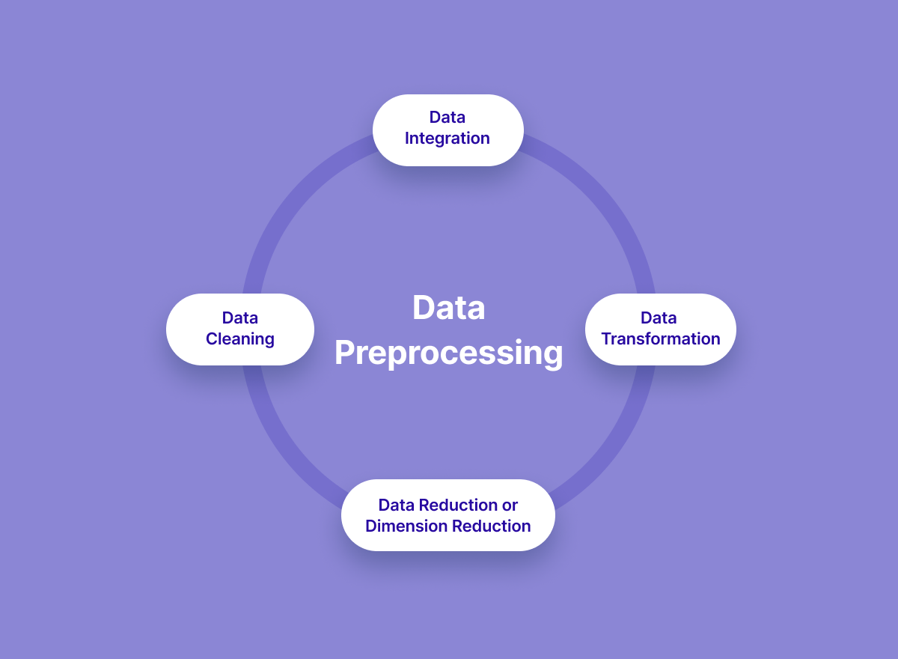

Slide 11
Steps for Image Preprocessing
The whole preprocessing pipeline:
Read in image
Apply masks
Resize image to desired size
Add Gaussian noise to increase Robustness

Slide 12
Data Augmentation
Data augmentation is a process of artificially increasing the amount of data by generating new data points from existing data. This includes adding minor alterations to data or using machine learning models to generate new data points in the latent space of original data to amplify the dataset.
Data Augmentation is performed with the help of the Keras preprocessing layers .

Slide 13
The Next Steps.
Step1 : The system uses convolutional neural network to classify the type of DR of the fundus image.
Step2: Training with the convolutional neural network that are generated.
Step3 : Save the model into the system for prediction of the test data.
Step 4 : Evaluate the result with the standard evaluation metrics like accuracy, precision, recall, and f1 score
Step 5 : Using Express API the web application is made and deployed in Heroku for presentation

Slide 14
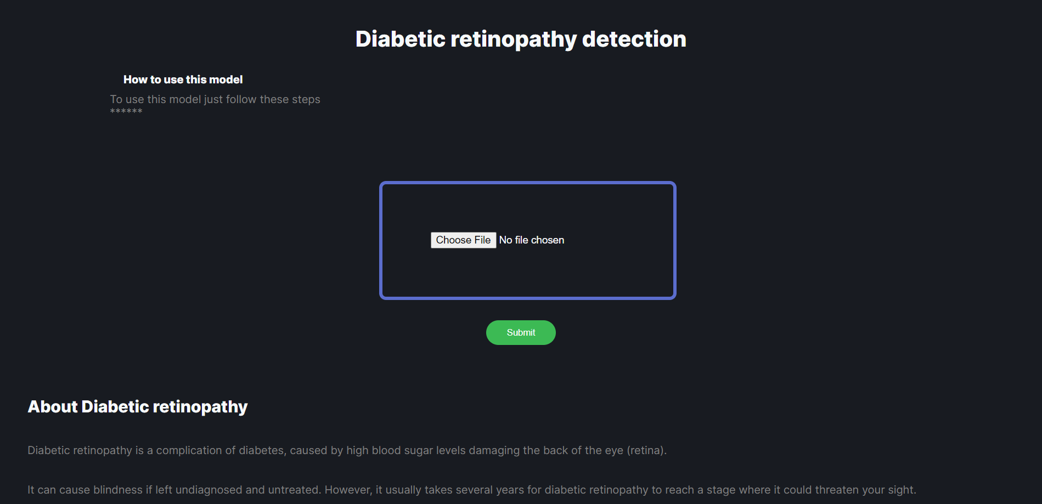
GUI Of Web Application

Slide 15
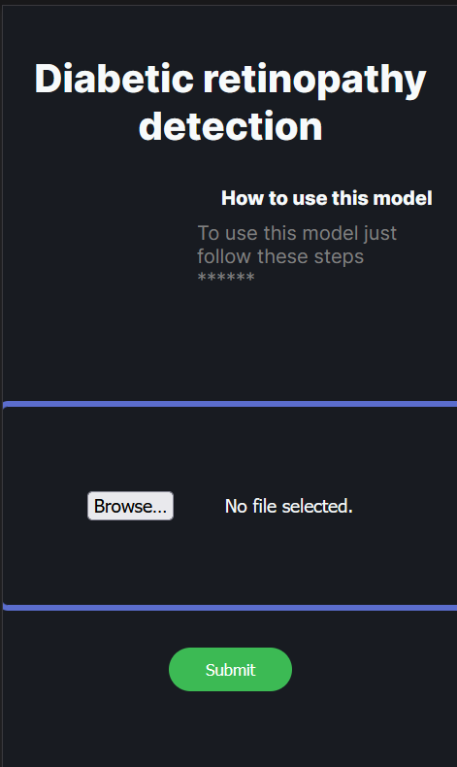
The app is also available on mobile!
App link : https://dr-ece-782.herokuapp.com/

Slide 16
Conclusion
In this project, a Image Processing based approach has been proposed for Diabetic Retinopathy classification.
Our system is a software solution to process fundus images and detect Diabetic Retinopathy, the most common eye disease.
Our application creates an opportunity for early detection of this disease which means that the chances of recovery will increase and the possibility of vision loss in patients will be reduced in the future.
By taking some random images any doctor can identify the accurate results whereas in traditional approach too much time, money are taken to detect the cases correctly.
Patient needs to go through a series of complicated tests to actually detect the case. The process can be simplified with the help of this model.

Slide 17
References
Dataset - https://github.com/FDU-VTS/Awesome-Diabetic-Retinopathy-Detection#codes
Blindness detection (Diabetic retinopathy) using Deep learning on Eye retina images
Kanika Verma; Prakash Deep; A. G. Ramakrishnan (2011), Detection and classification of diabetic retinopathy using retinal images, Annual IEEE India Conference, India
Ling Dai, Liang Wu, Huating Li, Chun Cai, Qiang Wu, Hongyu Kong, Ruhan Liu, Xiangning Wang, Xuhong Hou, Yuexing Liu, Xiaoxue Long, Yang Wen, Lina Lu, Yaxin Shen, Yan Chen, Dinggang Shen, Xiaokang Yang, Haidong Zou, Bin Sheng & Weiping Jia (2021), Diabetic Retinopathy Detection using Deep Learning, Nature Communications Conference, Beijing
Geoffrey E. Hinton Alex Krizhevsky, Ilya Sutskever (2012), ImageNet Classification with Deep Convolutional Neural Networks. Neural Information Processing Systems, Advancements in Neural Information Processing, Sweden.

Slide 18
THANK YOU

